Slide 1
Literacy Instruction in the
LISD Dual Language
Instructional Model
Dual Language Parent Collaborative
October 18, 2012

Slide 2
Position Statement
Achieving high standards of literacy for every child in the United States is a shared responsibility of schools, early childhood programs, families, and communities.
But teachers of young children… have a unique responsibility to promote children's literacy development, based on the most current professional knowledge and research.
National Association for the Education of Young Children (NAEYC) and International Reading Association (1998)

Slide 3
Professional Knowledge & Research
Balanced Literacy is the LISD Literacy Instructional Model.
Balanced Literacy is a framework designed to help all students learn to read and write effectively.
Balanced Literacy is a model for teaching children in a student-centered classroom.

Slide 4
LISD Dual Language
Literacy Instructional Model
Simultaneous Literacy Instruction is formal literacy instruction in two languages beginning in Kindergarten without translation.
Simultaneous Literacy Instruction utilizes the Balanced Literacy Model.

Slide 5
The Details…
Simultaneous Literacy is WHAT & WHEN…
Spanish Language Arts and English Language Arts instruction; separated through instructional time.
Balanced Literacy is HOW…
Best practice for model of teaching literacy.

Slide 6
What is Balanced Literacy?
Reading Workshop
Components of Balanced Literacy
  Read Aloud
  Shared Reading
  Guided Reading
  Reading Conferences
  Independent Reading
  Word Study

Slide 7
What is Balanced Literacy?
Writing Workshop
Components of Balanced Literacy
  Shared Writing
  Interactive Writing
  Guided Writing
  Writing Conferences
  Independent Writing
  Sharing/Reflections
  Word Study

Slide 8
What can I expect?
Spanish Reading..Let’s start with the vowels!
Oral Language Expression-playing with sounds, singing, mimicking expressions and phrases of the teacher, commands.
Writing- inventive spelling to communicate a meaningful message.

Slide 9
More on Inventive Writing
There is a danger that if teachers place too much emphasis on correctness, students may not take the risks needed to grow as writers. The student’s concern with producing conventional writing stifles the inventive force.
Teaching Reading and Writing in Spanish and English,
Yvonne S. Freeman & David E. Freeman, 2006.

Slide 10
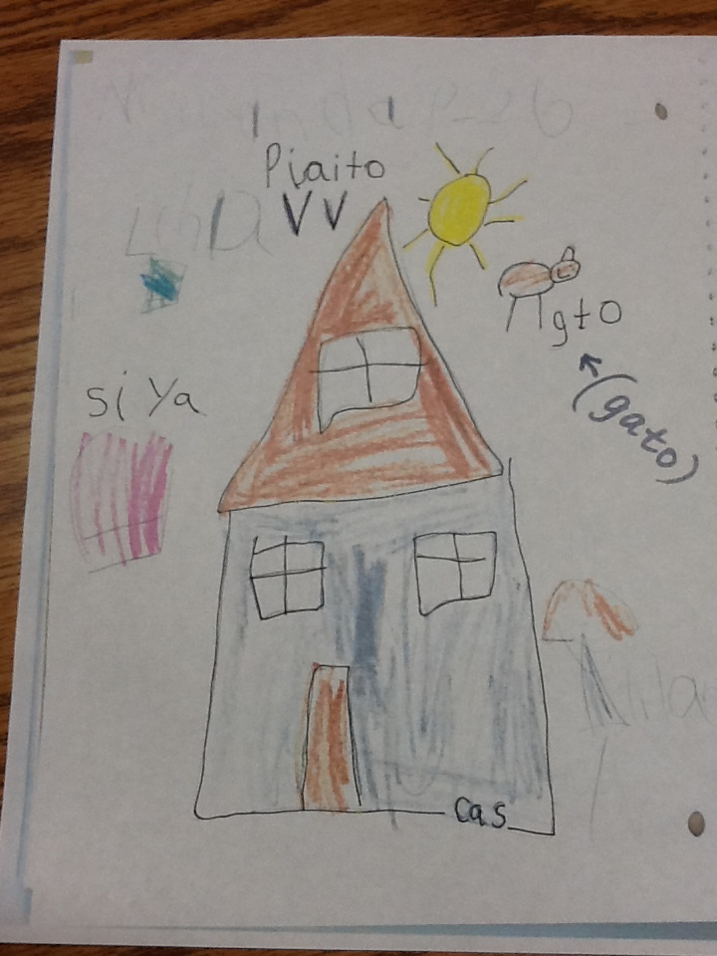

Slide 11
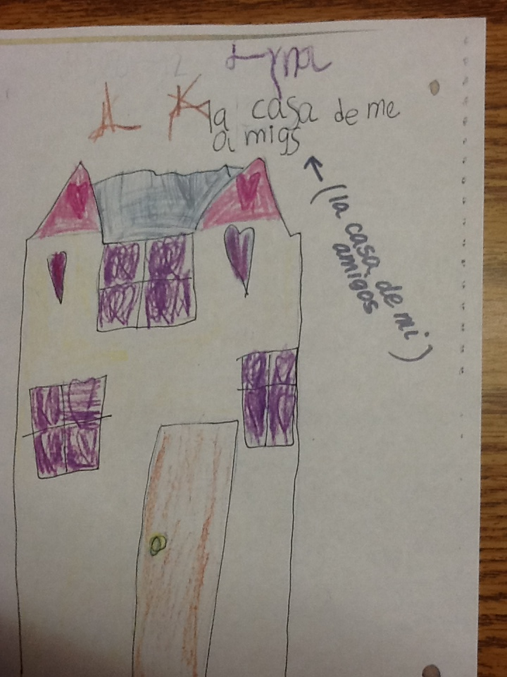

Slide 12
